Slide 1
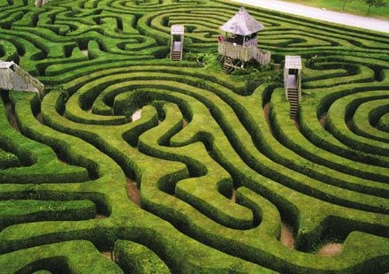
Lecture 1.2: Search I

Slide 2

Question
A farmer wants to get his cabbage, goat, and wolf across a river. He has a boat that only holds two. He cannot leave the cabbage and goat alone or the goat and wolf alone. How many river crossings does he need?
4
5
6
7
no solution
1

Slide 3
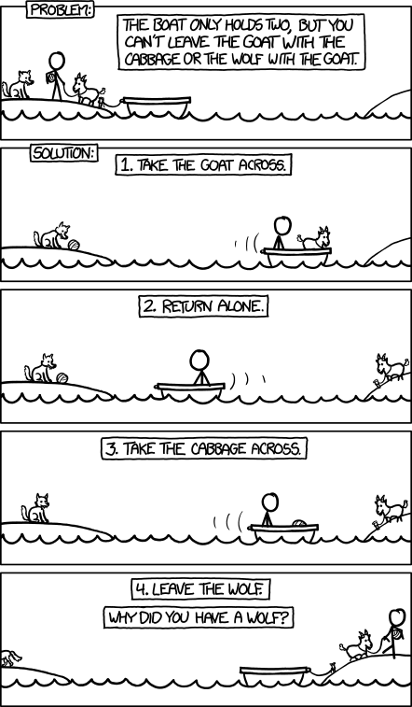
The real question is: How can we get a machine to do solve all problems like this automatically? One of the things we need is a systematic approach that considers all the possibilities. We will see that search problems define the possibilities, and search algorithms explore these possibilities.
3

Slide 4
Course plan
Search problems
Markov decision processes
Constraint satisfaction problems
Adversarial games
Bayesian networks
Reflex
States
Variables
Logic
”Low-level intelligence”
”High-level intelligence”
Machine learning
5

Slide 5
we have worked with only the simplest types of models — reflex models. We used these as a starting point to explore machine learning. Now we will proceed to the first type of state-based models, search problems.

Slide 6
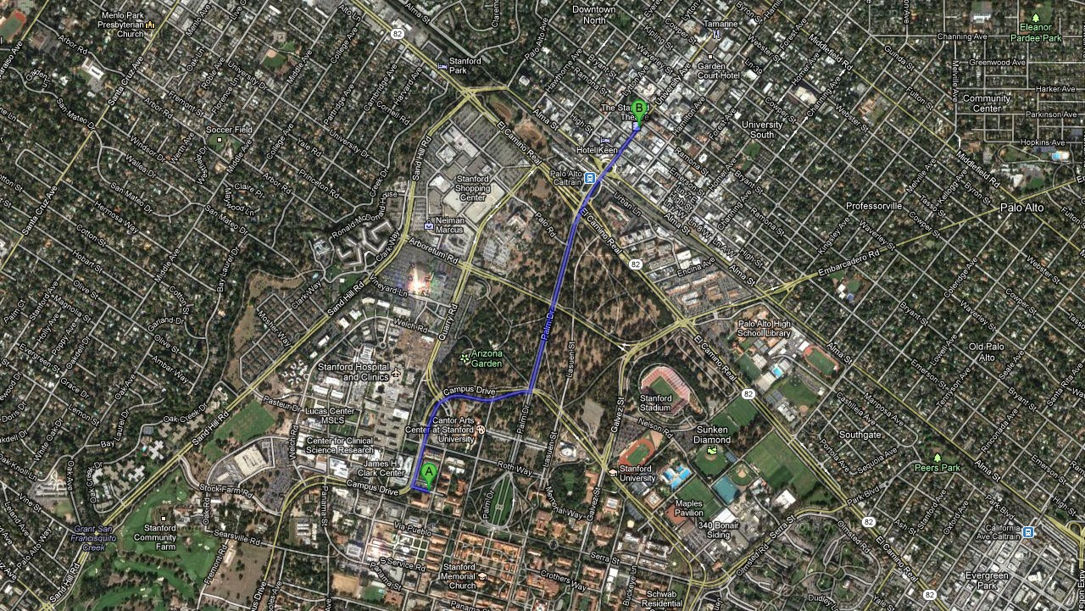
Application: route finding
Objective: shortest? fastest? most scenic?
Actions: go straight, turn left, turn righ
Route finding is perhaps the most canonical example of a search problem. We are given as the input a map, a source point and a destination point. The goal is to output a sequence of actions (e.g., go straight, turn left, or turn right) that will take us from the source to the destination.
We might evaluate action sequences based on an objective (distance, time, or pleasantness).
7

Slide 7
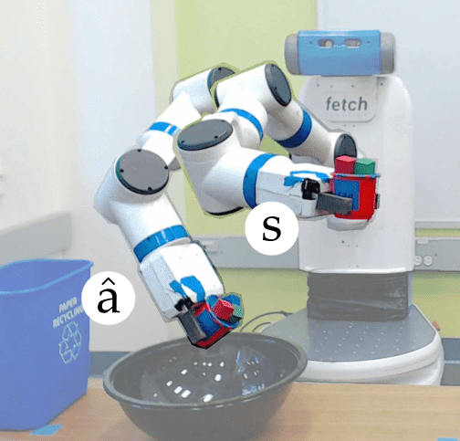
Application: robot motion planning
Objective: fastest? most energy efficient? safest? most expressive?
Actions: translate and rotate joints
In robot motion planning, the goal is get a robot to move from one position/pose to another. The desired output trajectory consists of individual actions, each action corresponding to moving or rotating the joints by a small amount.
Again, we might evaluate action sequences based on various resources like time or energy.
9

Slide 8
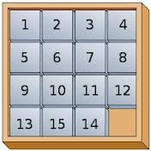
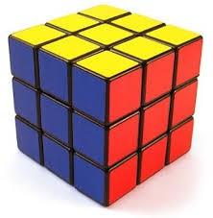
Application: solving puzzles
Objective: reach a certain configuration
Actions: move pieces (e.g., Move12Down)
In solving various puzzles, the output solution can be represented by a sequence of individual actions. In the Rubik’s cube, an action is rotating one slice of the cube. In the 15-puzzle, an action is moving one square to an adjacent free square.
In puzzles, even finding one solution might be an accomplishment. The more ambitious might want to find the best solution (say, minimize the number of moves).
11

Slide 9
Application: machine translation
la maison bleue
the blue house
Objective: fluent English and preserves meaning
Actions: append single words (e.g., the)
In machine translation, the goal is to output a sentence that’s the translation of the given input sentence. The output sentence can be built out of actions, each action appending a word or a phrase to the current output.
13

Slide 10
Beyond reflex
Classifier (reflex-based models):
x
f
single action y ∈ {−1, +1}
Search problem (state-based models):
x
f
action sequence (a₁, a₂, a₃, a₄, . . . )
15

Slide 11
machine learning of reflex-based models
linear predictors and neural networks that output either a +1 or −1 (for binary classification) or a real number (for regression).
While reflex-based models were appropriate for some applications such as sentiment classification or spam filtering, the applications we will look at today, such as solving puzzles, demand more.
To tackle these new problems, we will introduce search problems, our first instance of a state-based model.
In a search problem, in a sense, we are still building a predictor f which takes an input x, but f will now return an entire action sequence, not just a single action.
can’t I just apply a reflex model iteratively to generate a sequence?
While that is true, the search problems that we’re trying to solve importantly require reasoning about the consequences of the entire action sequence and cannot be tackled by myopically predicting one action at a time and a bit strong, since sometimes a search problem can be solved by a reflex-based model. You could have a massive lookup table that told you what the best action was for any given situation. It is interesting to think of this as a time/memory tradeoff where reflex-based models are performing an implicit kind of caching.

Slide 12
Paradigm
Modeling
Inference
Learning
The modeling-inference-learning paradigm. For reflex-based classifiers, modeling consisted of choosing the features and the neural network architecture.
inference was trivial forward computation of the output given the input.
learning involved using stochastic gradient descent on the gradient of the loss function, which might involve backpropagation.
Today, we will focus on the modeling and inference part of search problems.
17

Slide 13
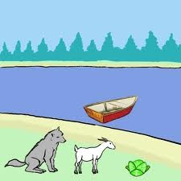
Farmer
Tree search
Cabbage
Goat
Wolf
Actions:
F>
FC > FG > FW>
Fa< FC < FG < FW <
Approach: build a search tree (”what if?”)
20

Slide 14
For this problem, we have eight possible actions, which will be denoted by a concise set of symbols. For example, the action FGd means that the farmer will take the goat across to the right bank; Fa means that the farmer is coming back to the left bank alone.

Slide 15
FCGWǁ
FCd:1
FGd:1
FWd:1
GWǁFC
CWǁFG
CGǁFW
Fa:1 FCWǁG
FCd:1
FWd:1
WǁFCG
CǁFGW
Fa:1 FGa:1
Fa:1 FGa:1
FWǁCG
FGWǁC
FCǁGW
FCGǁW
FWd:1
FCd:1
GǁFCW
GǁFCW
Fa:1
Fa:1
FGǁCW
FGǁCW
FGd:1
FGd:1
ǁFCGW
ǁFCGW
22

Slide 16

Search problem
FCGWǁ
FCd:1
FGd:1
FWd:1
GWǁFC
CWǁFG
CGǁFW
Fa:1 FCWǁG
FCd:1
FWd:1
WǁFCG
CǁFGW
Definition: search problem
Fa:1 FGa:1 FWǁCG FGWǁC
Fa:1 FGa:1 FCǁGW FCGǁW
s_{start}: starting state
Actions(s): possible actions
Cost(s, a): action cost
Succ(s, a): successor
IsEnd(s): reached end state?
FWd:1
FCd:1
GǁFCW
GǁFCW
Fa:1
Fa:1
FGǁCW
FGǁCW
FGd:1
FGd:1
ǁFCGW
ǁFCGW
23

Slide 17
We will build what we will call a search tree. The root of the tree is the start state s_{start}, and the leaves are the end states (IsEnd(s) is true). Each edge leaving a node s corresponds to a possible action a ∈ Actions(s) that could be performed in state s. The edge is labeled with the action and its cost, written a : Cost(s, a). The action leads deterministically to the successor state Succ(s, a), represented by the child node.
In summary, each root-to-leaf path represents a possible action sequence, and the sum of the costs of the edges is the cost of that path. The goal is to find the root-to-leaf path that ends in a valid end state with minimum cost.
The search tree is used merely to visualize the computation of the search algorithms and study the structure of the search problem.
For the boat crossing example, we have assumed each action (a safe river crossing) costs 1 unit of time. We disallow actions that return us to an earlier configuration. The green nodes are the end states. The red nodes are not end states but have no successors (they result in the demise of some animal or vegetable). From this search tree, we see that there are exactly two solutions, each of which has a total cost of 7 steps.

Slide 18

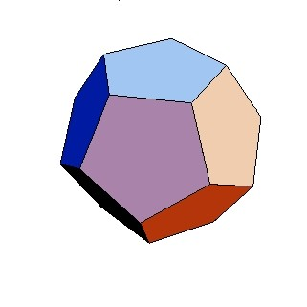
Transportation example
Example: transportation
Street with blocks numbered 1 to n. Walking from s to s + 1 takes 1 minute.
Taking a magic tram from s to 2s takes 2 minutes. How to travel from 1 to n in the least time?
[semi-live solution: TransportationProblem]
25

Slide 19
Let’s consider another problem and practice modeling it as a search problem. Recall that this means specifying precisely what the states, actions, goals, costs, and successors are.
To avoid the ambiguity of natural language, we will do this directly in code , where we define a Search Problem class and implement the methods: startState, isEnd and succAndCost.

Slide 20
Backtracking search
[whiteboard: search tree]
If b actions per state, maximum depth is D actions:
Memory: O(D) (small)
Time: O(b^{D} ) (huge) [2⁵⁰ = 1125899906842624]
27

Slide 21
How do we construct an algorithm for finding a minimum cost path (not necessarily unique)?
We will start with backtracking search, the simplest algorithm which just tries all paths.
The algorithm is called recursively on the current state s and the path leading up to that state. If we have reached a goal, then we can update the minimum cost path with the current path. Otherwise, we consider all possible actions a from state s, and recursively search each of the possibilities.
Graphically, backtracking search performs a depth-first traversal of the search tree. What is the time and memory complexity of this algorithm?
To get a simple characterization, assume that the search tree has maximum depth D(each path consists of D actions/edges) and that there are b available actions per state (the branching factor is b).
It is easy to see that backtracking search only requires O(D) memory (to maintain the stack for the recurrence), which is as good as it gets.
However, the running time is proportional to the number of nodes in the tree, since the algorithm needs
to check each of them. The number of nodes is 1 + b + b² +… · · · + b^{D} =
_{b}D+1₋₁
= O(b^{D}). Note that
b−1
the total number of nodes in the search tree is on the same order as the number of leaves, so the cost is always dominated by the last level.

Slide 22

Backtracking search
Algorithm: backtracking search
def backtrackingSearch(s, path):
If IsEnd(s): update minimum cost path For each action a ∈ Actions(s):
Extend path with Succ(s, a) and Cost(s, a) Call backtrackingSearch(Succ(s, a), path)
Return minimum cost path
[semi-live solution: backtrackingSearch]
29

Slide 23
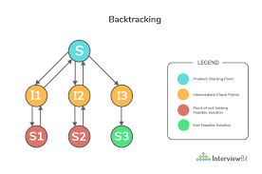

Slide 24

Depth-first search
Assumption: zero action costs
Assume action costs Cost(s, a) = 0.
Idea: Backtracking search + stop when find the first end state. If b actions per state, maximum depth is D actions:
Space: still O(D)
Time: still O(b^{D} ) worst case, but could be much better if solutions are easy to find
30

Slide 25
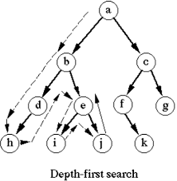

Slide 26
Backtracking search will always work (i.e., find a minimum cost path), but there are cases where we can do it faster.
Suppose we make the assumption that all the action costs are zero. In other words, all we care about is finding a valid action sequence that reaches the goal. Any such sequence will have the minimum cost: zero.
In this case, we can just modify backtracking search to not keep track of costs and then stop searching as soon as we reach a goal. The resulting algorithm is depth-first search (DFS), which should be familiar to you. The worst time and space complexity are of the same order as backtracking search. In particular, if there is no path to an end state, then we have to search the entire tree.
However, if there are many ways to reach the end state, then we can stop much earlier without exhausting the search tree. So DFS is great when there are an abundance of solutions.

Slide 27
Breadth-first search
Assumption: constant action costs
Assume action costs Cost(s, a) = c for some c ≥ 0.
Idea: explore all nodes in order of increasing depth. Legend: b actions per state, solution has d actions
Space: now O(b^{d}) (a lot worse!)
Time: O(b^{d}) (better, depends on d, not D)
32

Slide 28
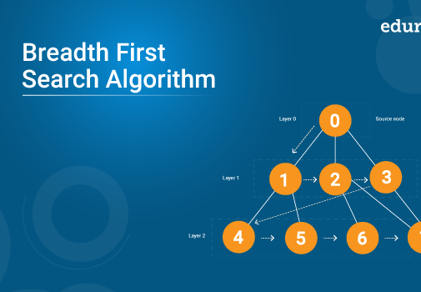

Slide 29
Breadth-first search (BFS), which should also be familiar, makes a less stringent assumption, that all the action costs are the same non-negative number. This effectively means that all the paths of a given length have the same cost.
BFS maintains a queue of states to be explored. It pops a state off the queue, then pushes its successors back on the queue.
BFS will search all the paths consisting of one edge, two edges, three edges, etc., until it finds a path that reaches a end state. So if the solution has d actions, then we only need to explore O(b^{d}) nodes, thus taking that much time.
However, a potential show-stopper is that BFS also requires O(b^{d}) space since the queue must contain all the nodes of a given level of the search tree. Can we do better?

